Slide 1

Canopy Health
Offering Employees a New Concept in Care!

Slide 2

Considering Health Net CanopyCare HMO?
Open enrollment is the time of year where you have the option to select plans that fit your lifestyle. As part of your offering you have access to the Canopy Health network of providers through the Health Net CanopyCare HMO.
Canopy Health believes you should be able to take an active role in your care, that is why we have created a provider network that offers you access to specialists where you live, work and play!

Slide 3

Do you already have a Canopy Health Provider?
Choose Canopy Health
To determine if you would benefit from participating in a plan that offers Canopy Health, simply answer this question:
Is your Primary Care Physician part of one of the following medical groups?
  Hill Physicians Medical Group
    East Bay
    San Francisco
  John Muir Health Physician Network
  Meritage Medical Network
  Santa Clara County IPA (SCCIPA)
  Dignity Health Medical Network – Santa Cruz
If you answered yes to this question, then you doctor is part of the Canopy Health provider network!

Slide 4
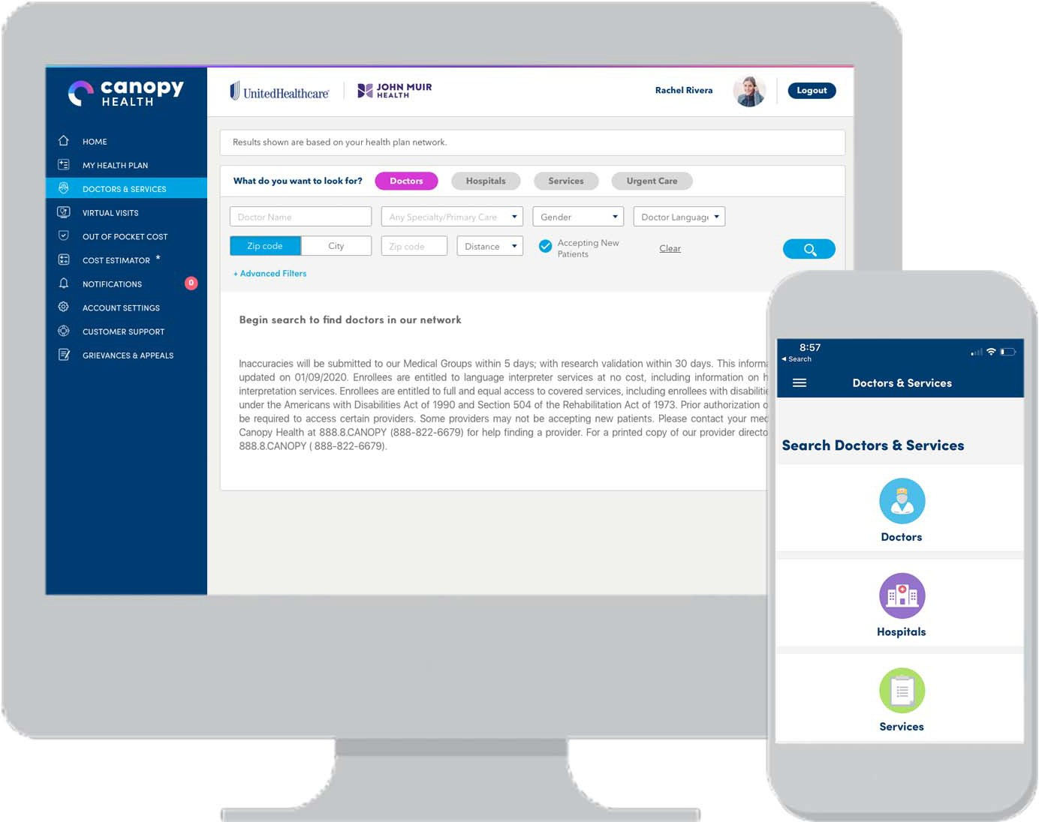
How to find a Canopy Health Provider?
Find A Doctor
Looking for a provider?
Check out the provider directory where you can search for a provider in the Canopy Health network. You can search by:
  Languages Spoken
  Services Provided
  Medical Group
  Accepting New Patients
Visit www.canopyhealth.com to access the provider directory

Slide 5




















CANOPY HEALTH PROVIDER NETWORK
Medical Groups
Hospitals
Physicians in our network are pioneering scientific innovation that leads to advancements in care.

Slide 6
Value Added Benefits for Choosing Canopy Health
A New Approach to Referrals
Canopy Health believes members should have an active role in their care. With Canopy Health members work with their primary care physician to make care choices that fit their lifestyle. Accessing care where you live, work and play!
Easy Access to Specialists
Members meet with their primary care physician (PCP) to explore treatment options.
If a specialist is required, your PCP will discuss with you the best option within our network.
Referral requests are processed quickly and efficiently, including alerting members and providers. Through the Alliance Referral Program common services offered by the approved specialist don’t require additional authorizations.
Upon approval, the member can schedule an appointment with the specialist.

Slide 7








Value Added Benefits for Choosing Canopy Health
Our new digital platforms help unify the Canopy Health alliance experience by empowering members with streamlined access to the online tools they need to monitor healthcare costs, find a doctor or other service, or virtually consult with a medical professional. Canopy Health offers the following features on the app and member portal:
  Search for Canopy Health providers
  Review your Benefit Summary
  Access your Virtual ID Card
  Access a Virtual Visit
  Access our Cost Estimator
  Review out-of-pocket accumulations
Cost Estimator
Video Visits
Out-of-Pocket Accumulator
Virtual ID Card
Benefits Summary
Mobile App
Doctors & Services
Member
Member Portal

Slide 8
Canopy Health Checklist?
1
2
Check out the Canopy Health Network
Visit the Canopy Health or Health Net website to choose a doctor participating in the provider network: www.CanopyHealth.com or UC Blue & Gold Provider Lookup
2
2
Learn More
To learn more about the Canopy Health Network and value added benefits of being a member, send us a note at chsupport@canopyhealth.com and we will get back to you within one business day!
3
2
Have More Questions?
Visit the Resource page on the Canopy Health website at www.CanopyHealth.com to learn more!
4
Schedule an Appointment with your Doctor
If you already have a primary care physician, this is a good time to schedule your annual wellness checkup and get up to date on any routine care you may need.
If you are selecting a new primary care physician schedule an appointment to get to know your doctor!

